Slide 1
MONTHLY SALES GROWTH
Dashboard analysis
BUSINESS PERFORMANCE REVIEW & STRATEGIC RECOMMENDATIONS
Prepared by: [Madhuja]

Slide 2
01
OBJECTIVE:
Analyze monthly sales performance to identify growth opportunities and profitability drivers.
Executive summary
02
KEY FINDINGS:
Total Sales: 29M
Total Profit: 8M
Average Sales Growth: 26.35%
Regional and product performance varies significantly
Sales show a noticeable decline after the initial months

Slide 3
Business problem statement
BUSINESS QUESTIONS:
- Why are sales declining after the initial months?
- Which regions generate maximum profitability?
- Which products drive business growth?
- How can profitability and growth be improved?
PROBLEM:
The business is experiencing inconsistent sales growth despite generating substantial revenue.

Slide 4
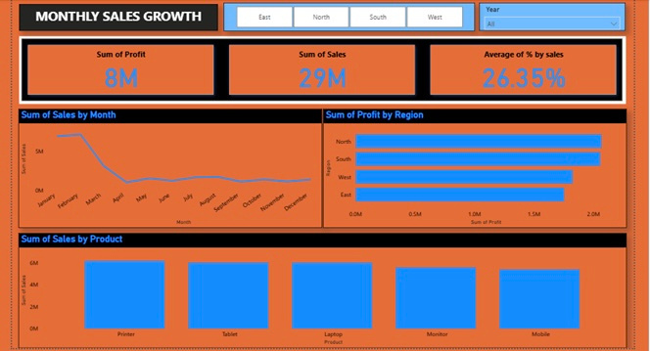

DASHBOARD OVERVIEW

Slide 5
KPI performance summary
OBSERVATION:
Total Sales: 29M
Total Profit: 8M
Avg. Sales Growth: 26.35%
Sales volume is strong but requires optimization to improve long-term growth.

Slide 6
01
INSIGHTS:
Peak sales observed in early months
Sharp decline from March onward
Recovery remained limited through year-end
Monthly trend analysis
02
BUSINESS IMPACT:
Reduced revenue momentum
Potential seasonal or operational challenges

Slide 7
01
FINDINGS:
North and South regions contribute the highest profits
East region underperforms
Regional Profit Analysis
02
OPPORTUNITIES:
Expand successful regional strategies
Investigate lower-performing markets

Slide 8
Product Performance Analysis
PRODUCT CONTRIBUTION:
TOP PERFORMERS:
LOWER CONTRIBUTORS:
Printer
Tablet
Laptop
Monitor
Mobile
RECOMMENDATION:
Focus inventory and marketing on high-performing products

Slide 9
01
02
03
Demand fluctuations
Regional sales imbalance
Product mix inefficiencies
04
05
Marketing effectiveness
Seasonal purchasing behavior
Root Cause Analysis
POTENTIAL DRIVERS:

Slide 10
Recommendations
SHORT-TERM ACTIONS:
✓ Launch regional campaigns
✓ Increase focus on top-selling products
✓ Improve sales monitoring
LONG-TERM ACTIONS:
✓ Build forecasting models
✓ Diversify product portfolio
✓ Optimize profit margins

Slide 11
Expected Business Outcomes
EXPECTED IMPROVEMENTS:
Increased sales consistency
Improved regional performance
Higher profit margins
Better decision-making
Conclusion:
Data-driven sales optimization can improve growth sustainability and maximize profitability across regions and products.

